Slide 1
Saliency Map Guided Decolorization
B00901087 潘柏丞
指導學長:張嘉洋
指導教授:簡韶逸

Slide 2
Outline
Saliency
Decolorization
Saliency Map Guided Decolorization
Experiment
Conclusion & Future work

Slide 3
Motivation
Computational Photography
HDR
Contrast Boosting
Decolorization

Slide 4
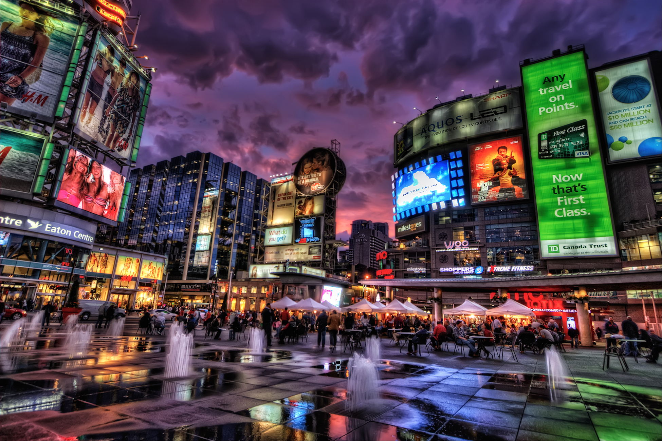
Motivation
Unnatural Artifacts in Computational Photography

Slide 5
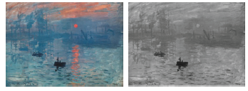
Decolorization

Slide 6

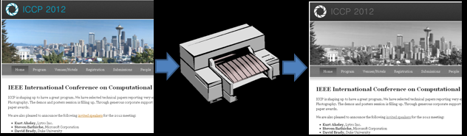
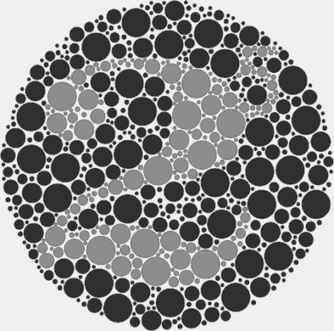
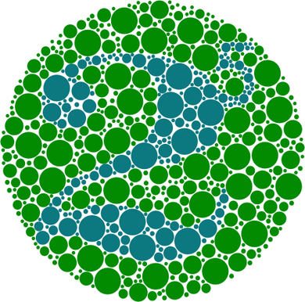
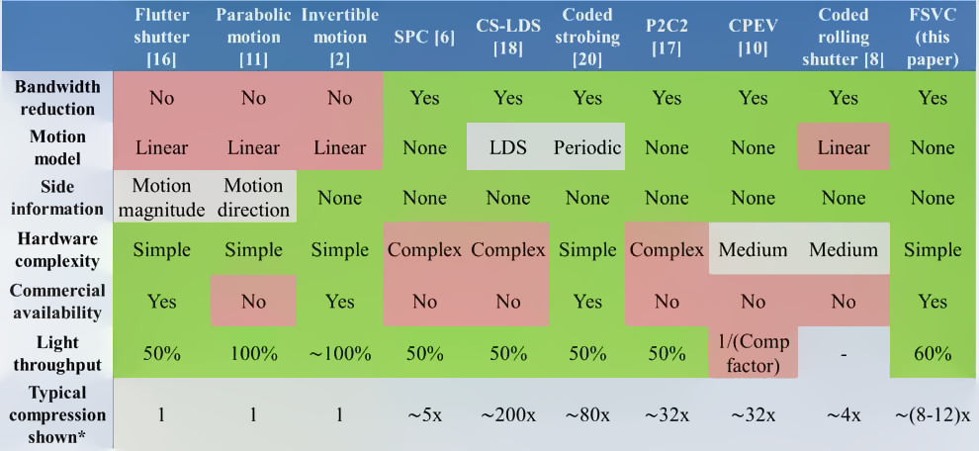
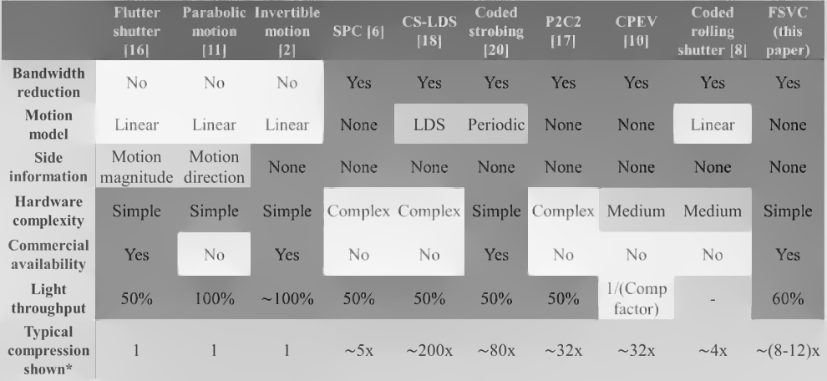
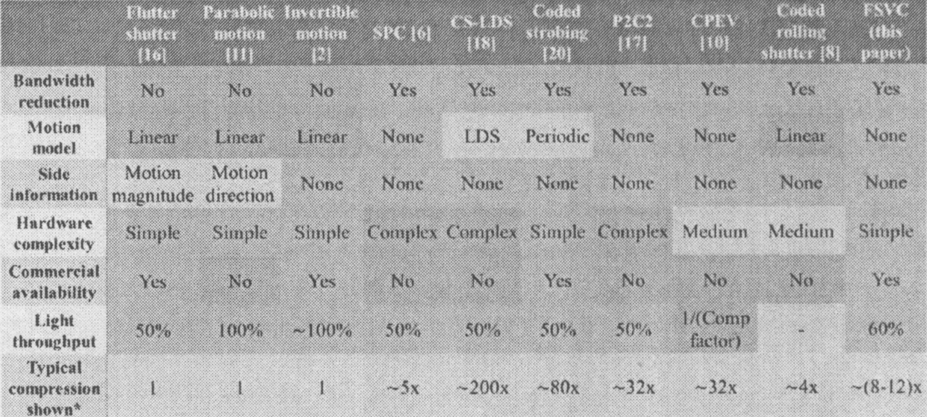


Why Decolorization?
Mono printers are still the majority.
Color-Blind

Slide 7
Why Decolorization?
Mono printers are still the majority.
Color-Blind

Slide 8
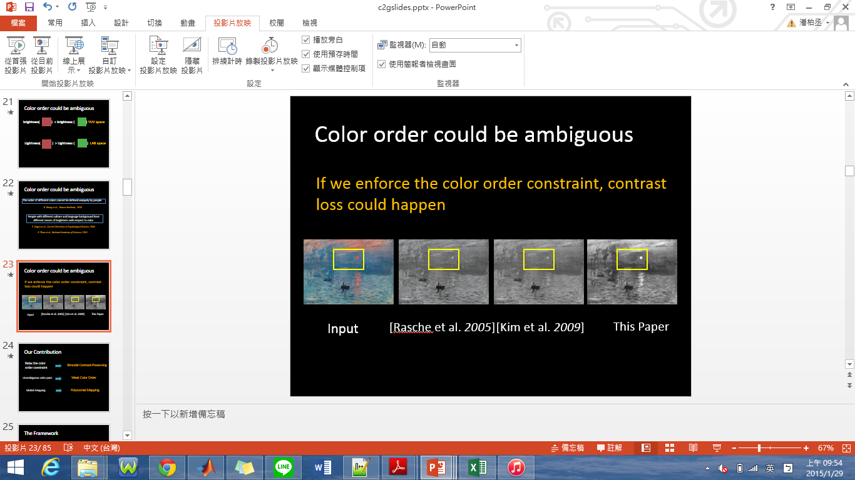
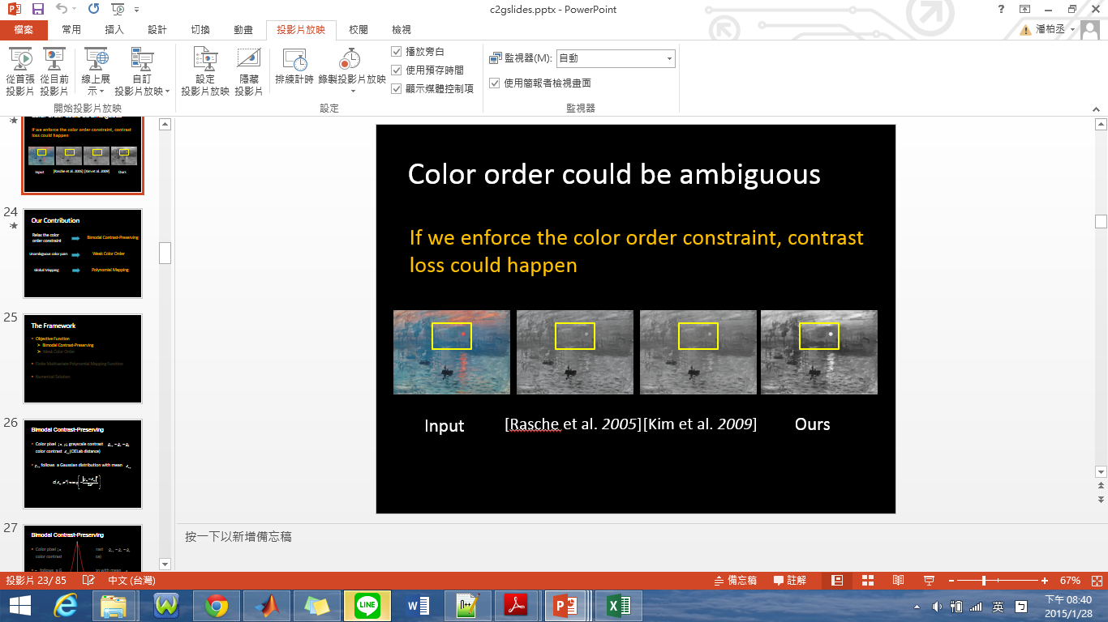
Contrast Preserving Decolorization
ICCP 2012

Slide 9
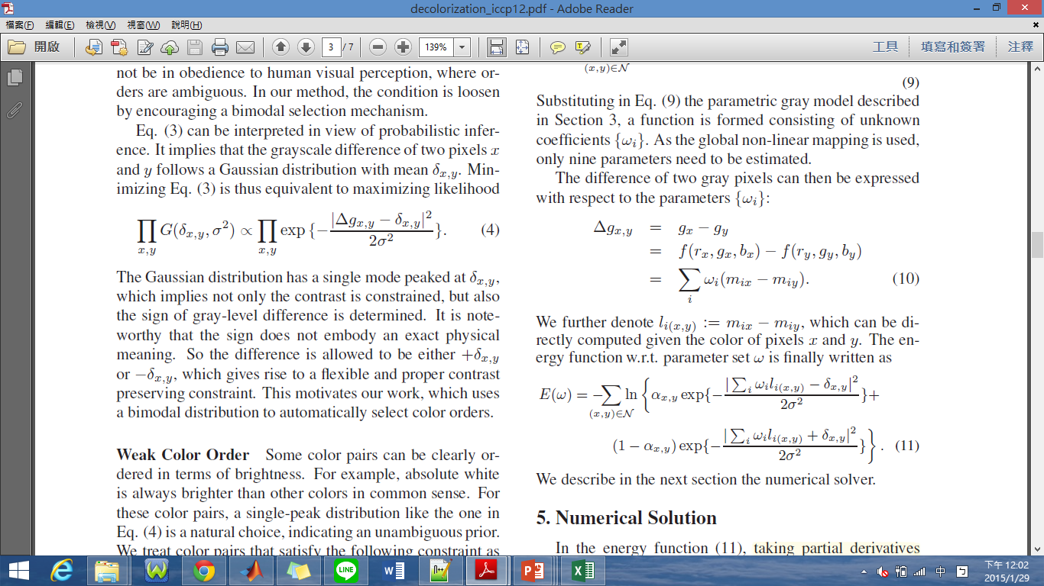
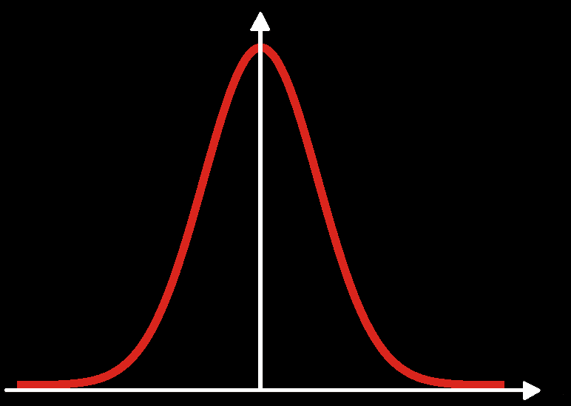
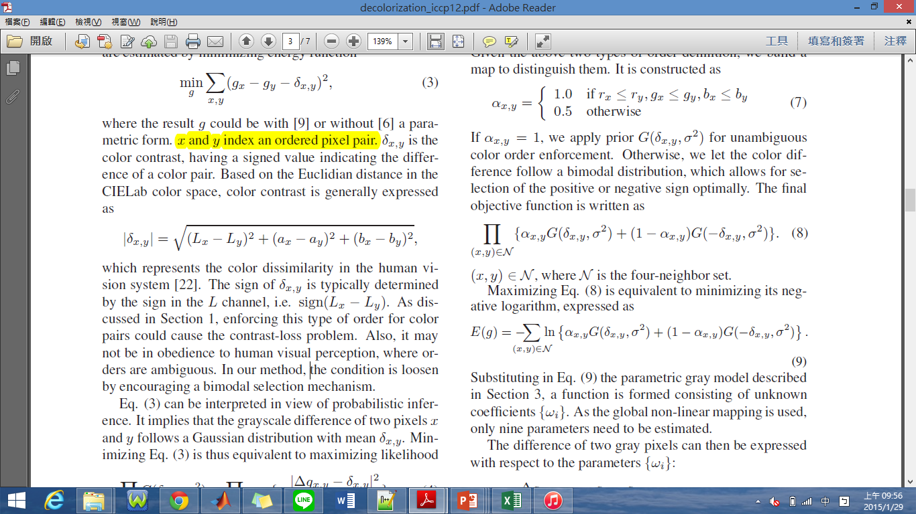
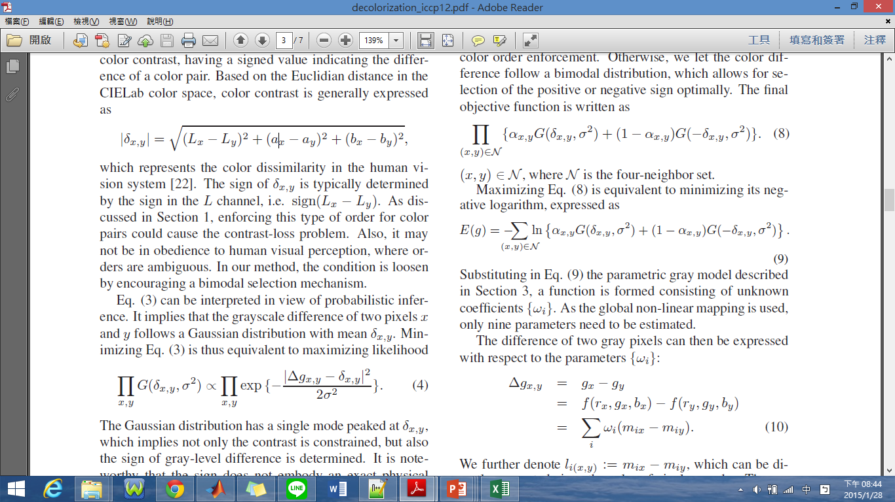
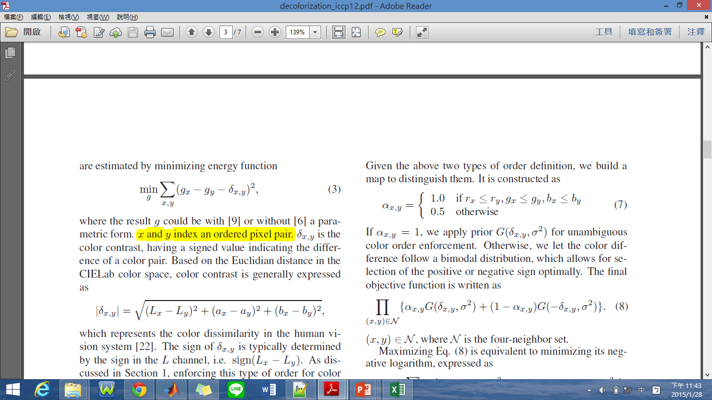
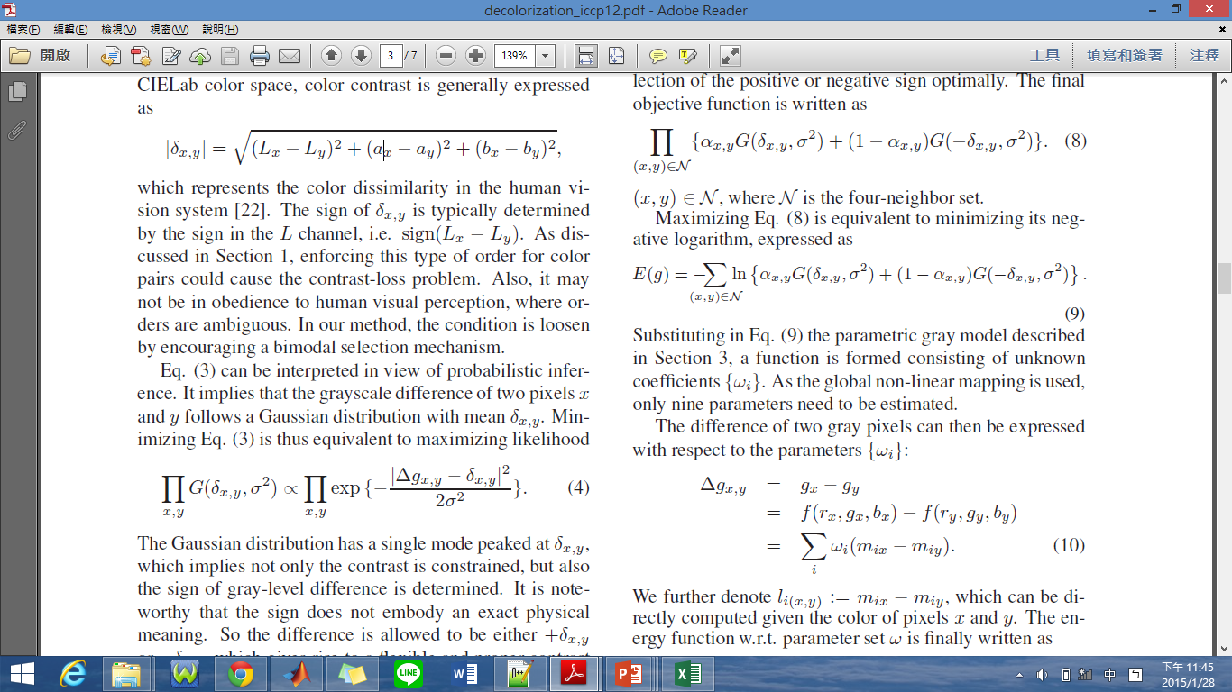
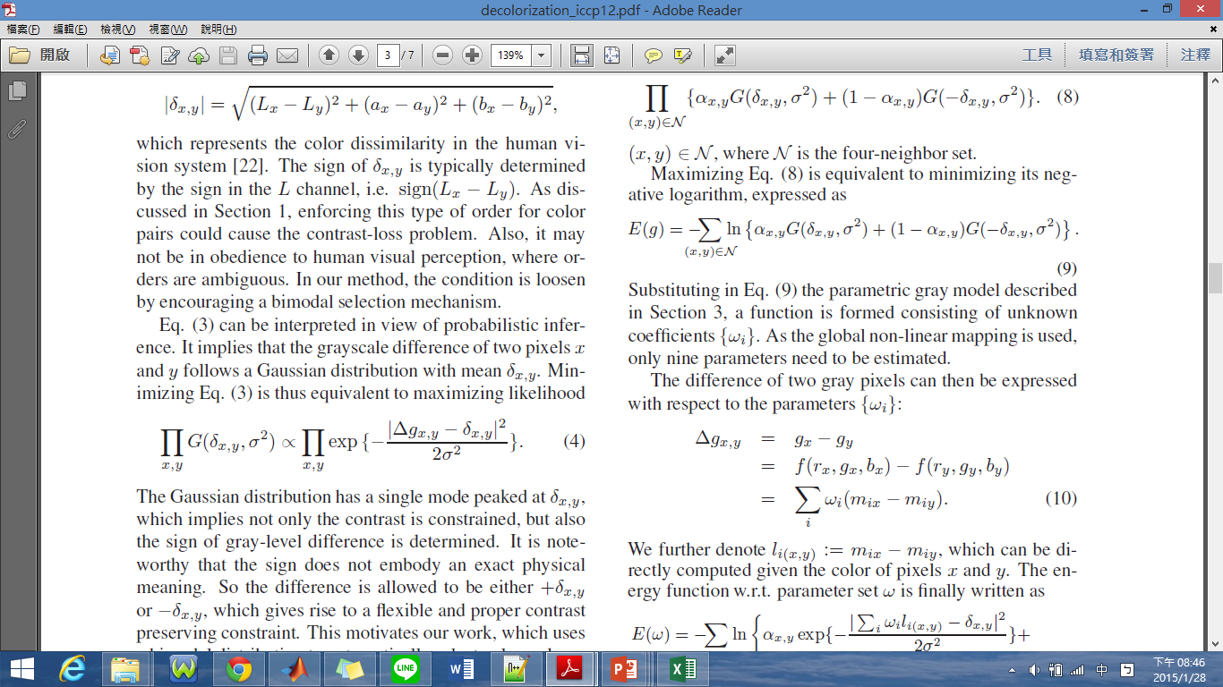
Contrast-Preserving Objective Function

Slide 10
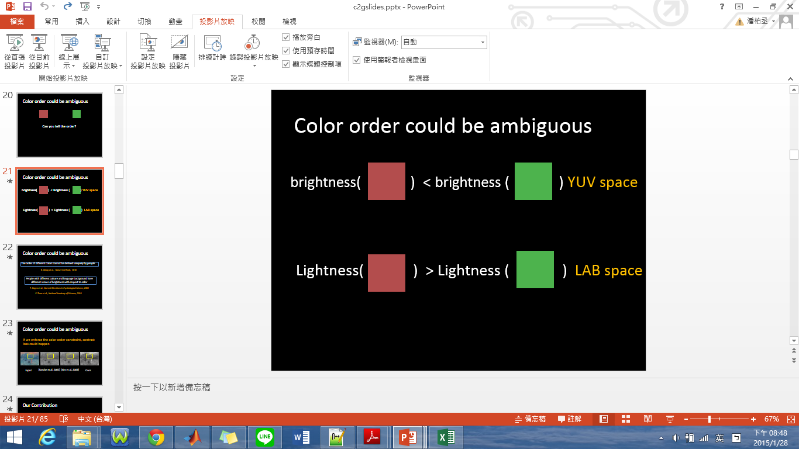
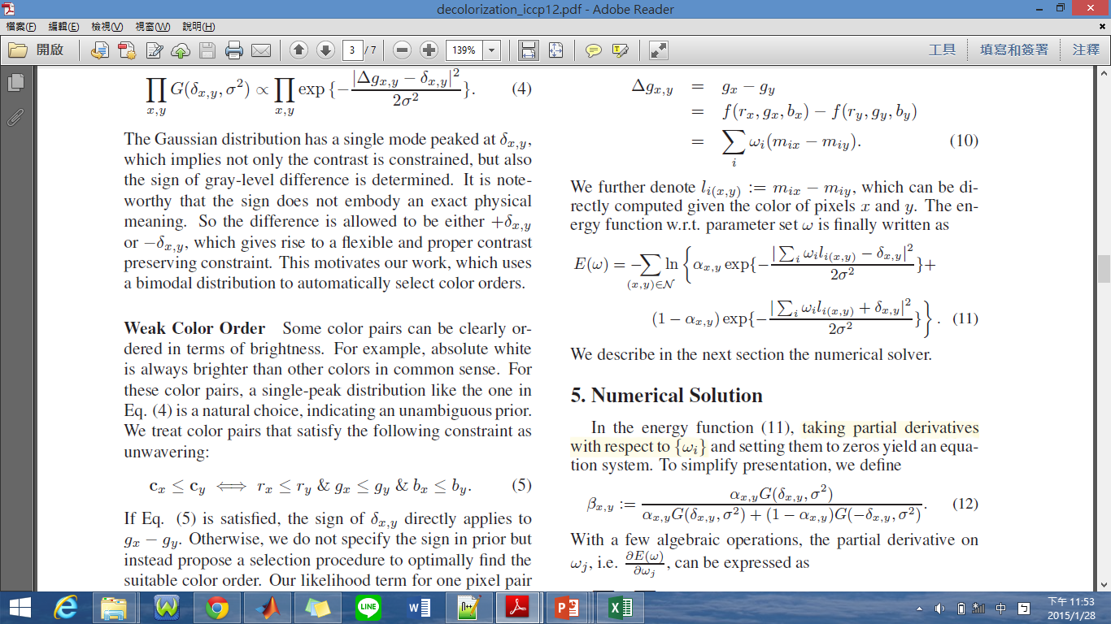
Weak Color Order
Unambiguous Color Pairs:

Slide 11
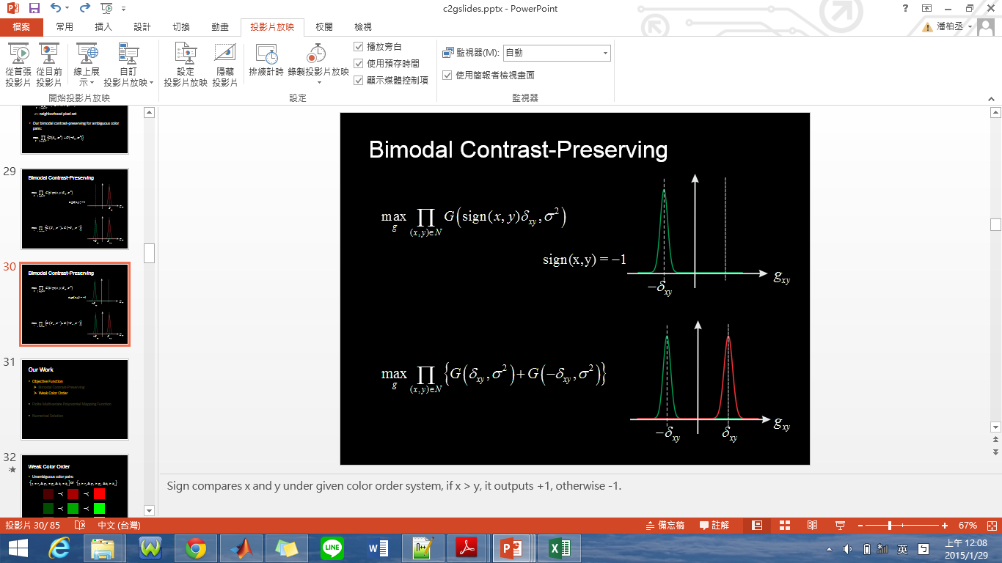
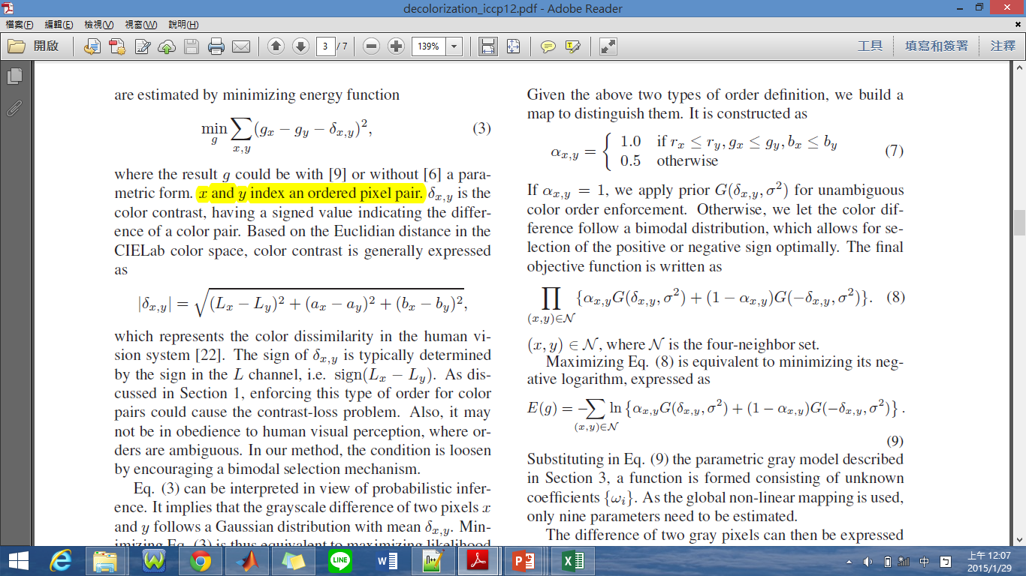
Bimodal Contrast-Preserving

Slide 12

Energy Function

Slide 13
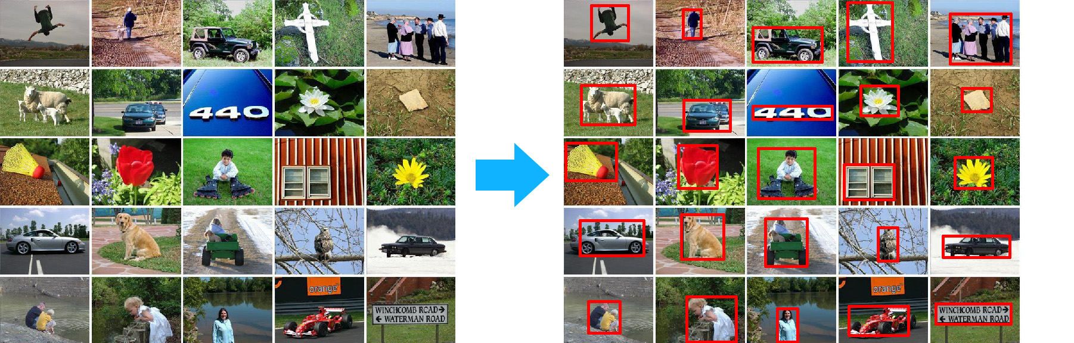
What is “Saliency” ?

Slide 14
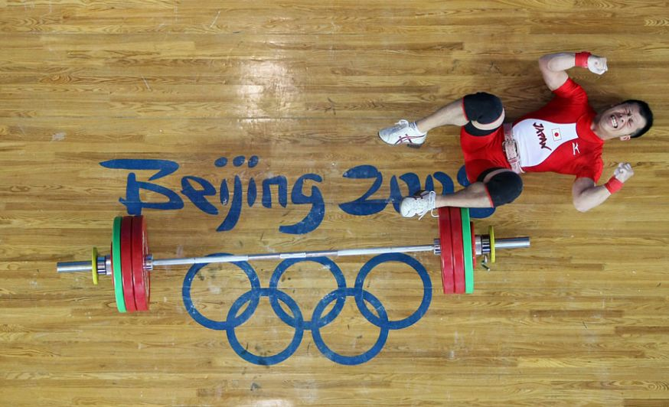

How to Get a Saliency Map?
Low-level
Color
Orientation
Size
Motion
Depth
High-level
People
Context
=> Bottom-up Approach
=> Top-down Approach

Slide 15




Bottom-Up Approach
Frequency-Tuned Method:

Slide 16
Top-Down Approach

Slide 17
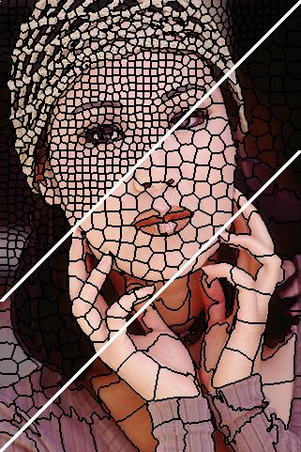
The Saliency Map I Survey
Fusing Generic Objectness and Visual Saliency for Salient Object Detection
Frequency-tuned Salient Region Detection
Global Contrast Based Salient Region Detection
Saliency Filters-Contrast Based Filtering for Salient Region Detection
Saliency Detection via Dense and Sparse Reconstruction
Saliency Detection via Graph-Based Manifold Ranking, CVPR 2013
Notes:
Color histogram
superpixel

Slide 18
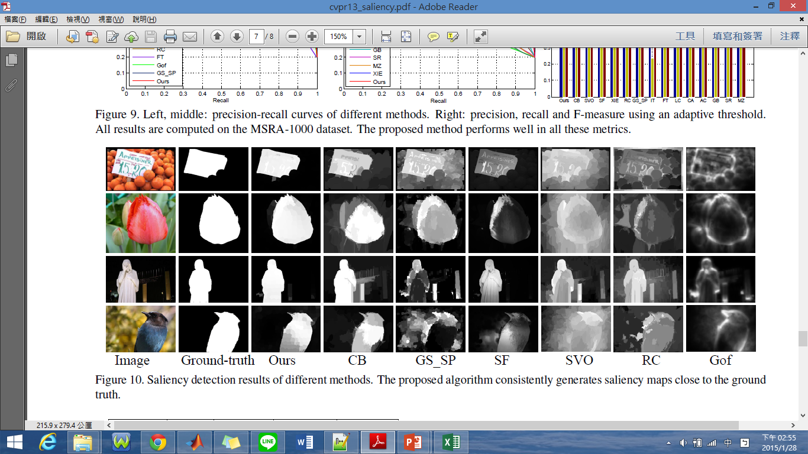
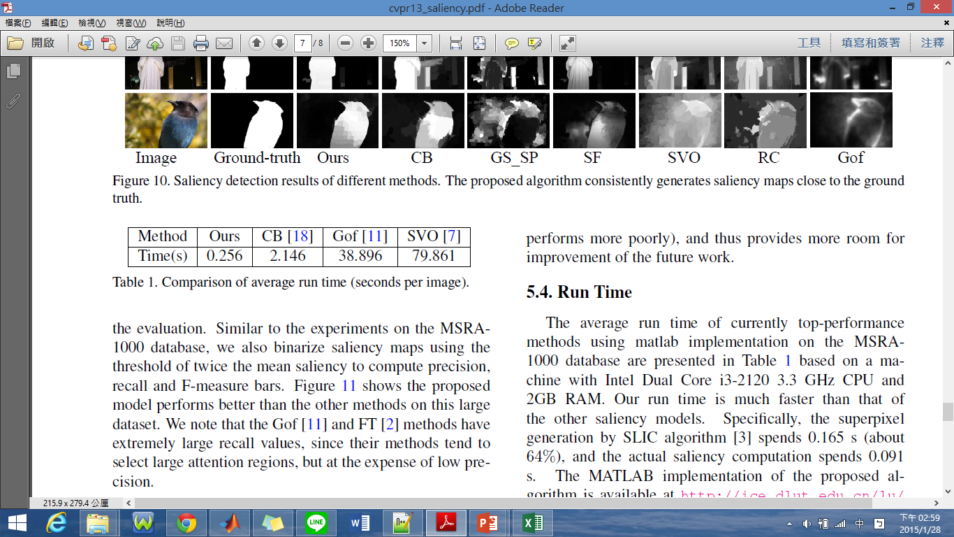
Why I Use This Method?
Gradient Map
Fast Running Time

Slide 19
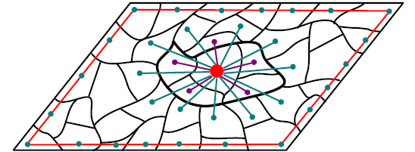
Graph Model

Slide 20
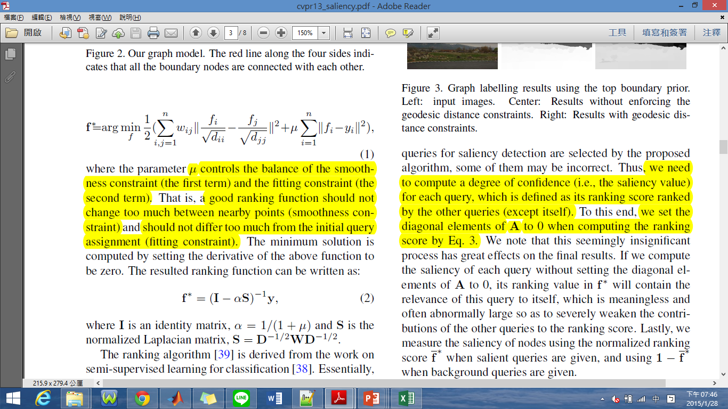
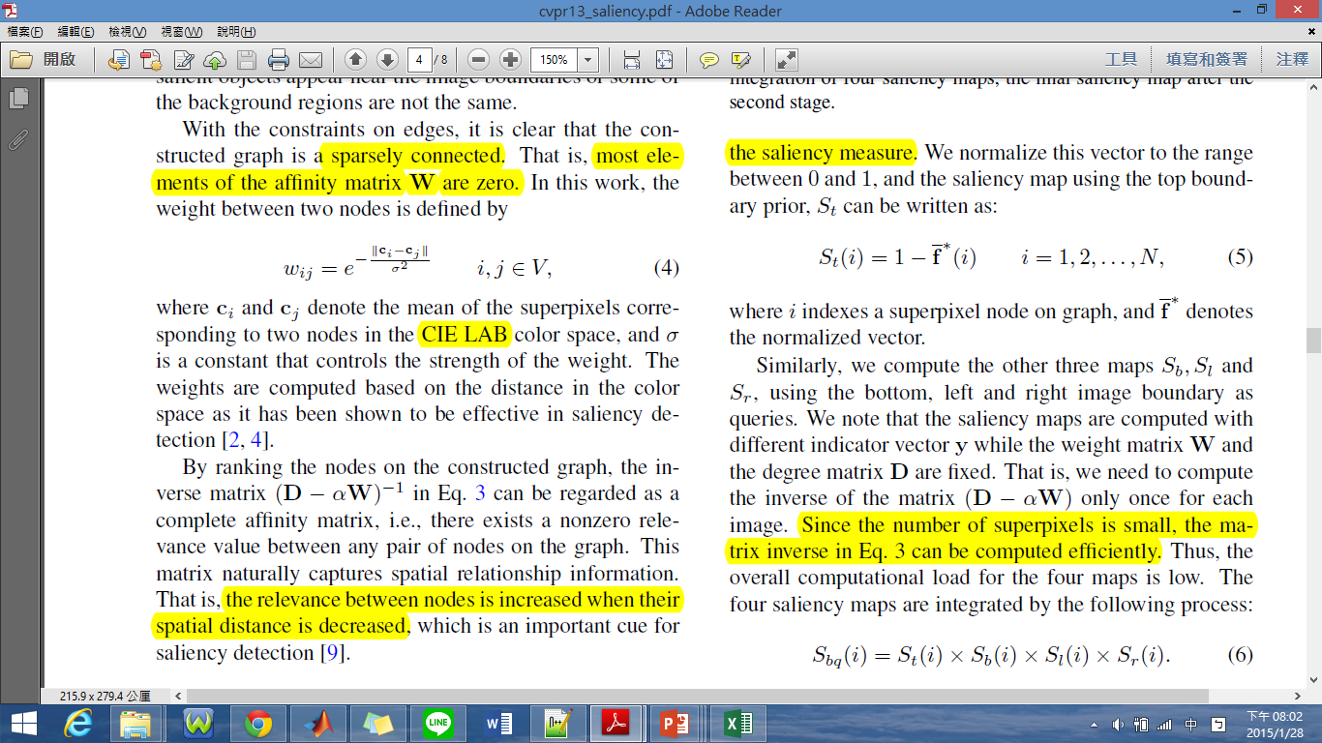
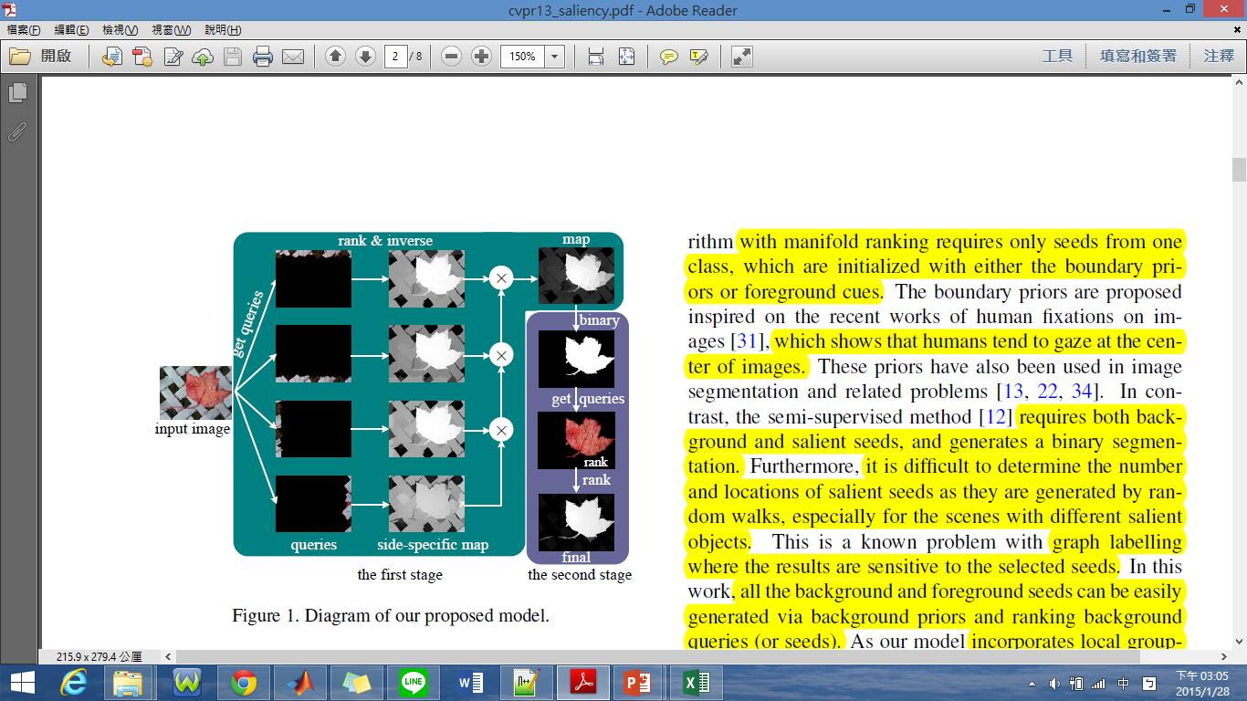
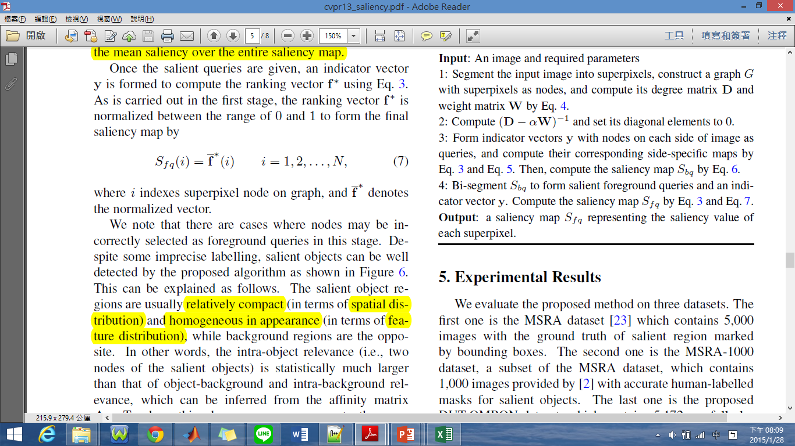
Algorithm Model

Slide 21
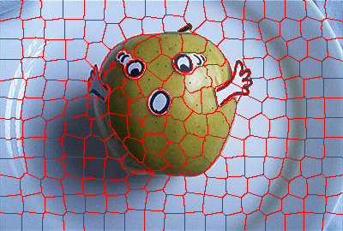

Saliency Map Result

Slide 22
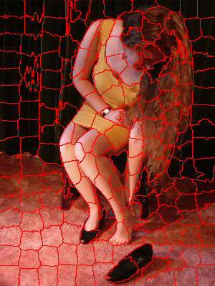

Saliency Map Result

Slide 23
Saliency Map & Decolorization

Slide 24
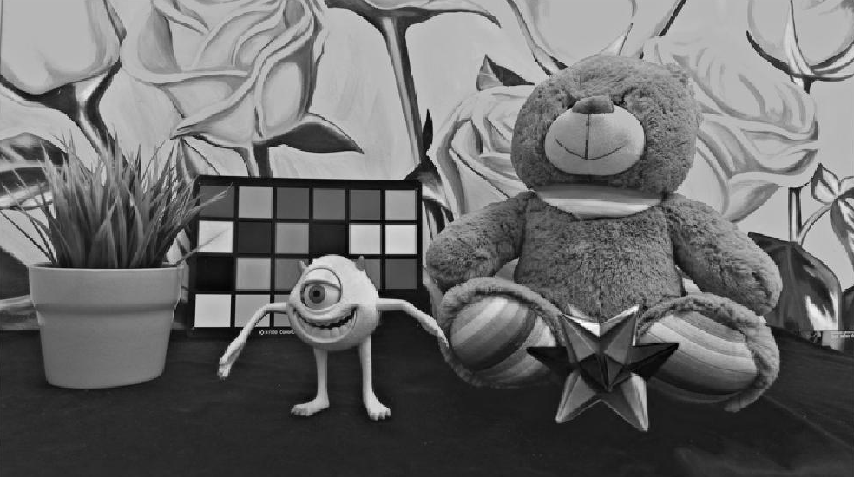
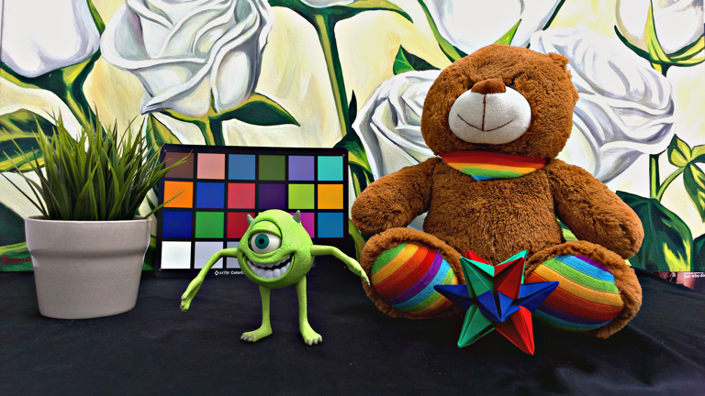
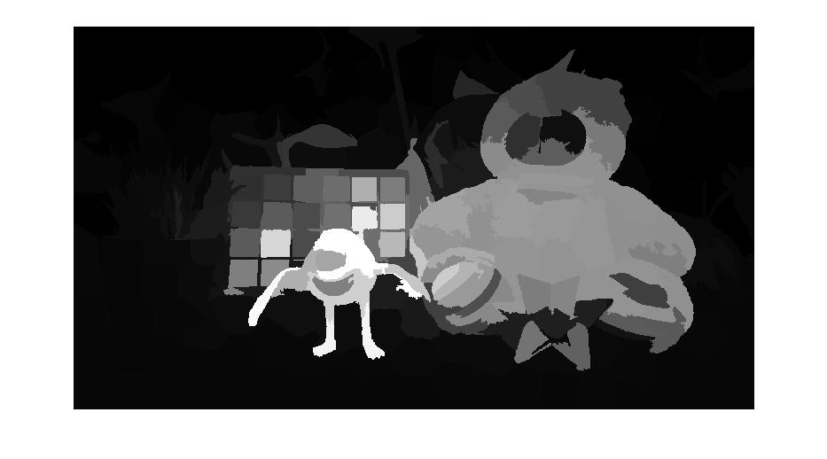
Result

Slide 25
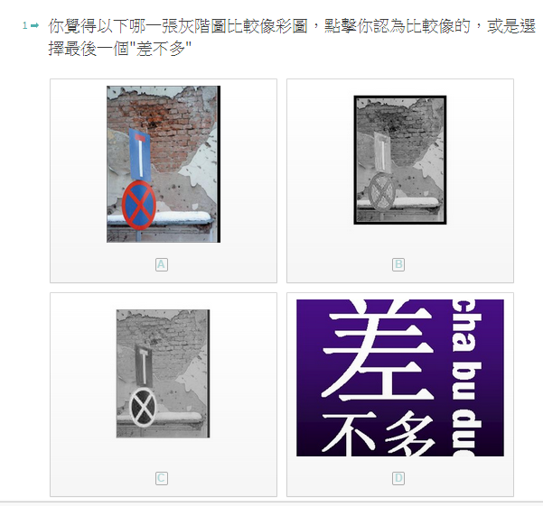
Experiment
15 images & 11 people
MSRA Dataset
Typeform
3 kinds of data:
Original Method
Saliency Map Guided
Manifold-ranking
Rectangle

Slide 26
Experimental Result
Manifold-ranking Method : Score = 1.139394
Original Method : Score = 1
Rectangle Saliency Method : Score = 0.860606

Slide 27
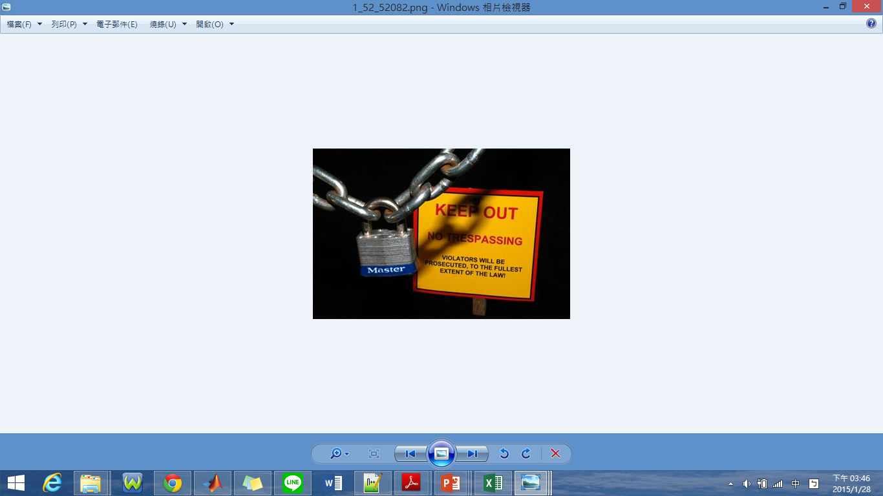
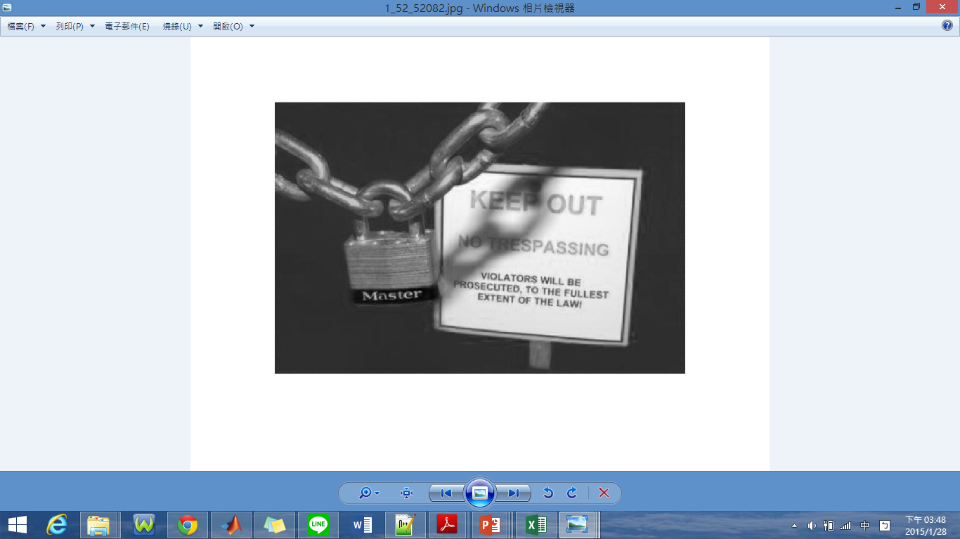
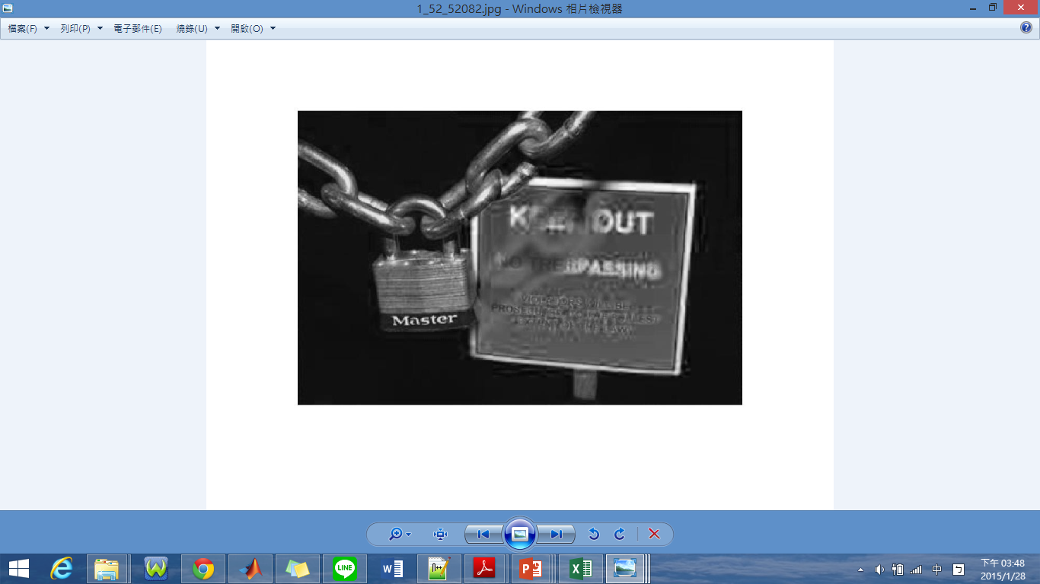
Limit
Manifold-ranking
Origin

Slide 28
Future Work
Decolorization
Saliency Map
Testing Data
HDR Scene

Slide 29
Thanks for your attention!!

